Slide 1
Dreamcast Development Environment
Dylan Bromley
Sega Of America
dylan.bromley@sega.com

Slide 2
Overview
Compiling Samples
Emulating the GD
Debugging a program
GD Mastering Overview

Slide 3
Development Environment
Command Line Compilers
  Hitachi C
  GNU C\C++
Integrated Interface
  Metrowerks Codewarrior Interface

Slide 4
F40 Example
Samples\Ninja3D\F40
Compiling a project
Emulating the GD
Debugging

Slide 5
Command Line Environments
Environment for GNU and Hitachi Compilers
All examples have .mak files
  BIN Flag
  Debug Flag
  GNU Flag
GMAKE
  Makes project

Slide 6
Compiling with Codewarrior
All examples have cw_proj directories
Drag and Drop project file to IDE
  Project\Make (F7)
Dreamcast Stationary is installed with the SDK

Slide 7
Emulating the GD
GD Workshop
  Definition of areas
  Placement of files
  Physical layout of GD

Slide 8
Definition of Data Areas
Low Density Area
  4 mins long and holds ~35MB of data
High Density Area
  112 mins long and holds ~1GB of data

Slide 9
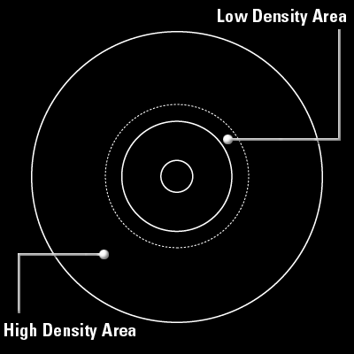
Data Area Layout

Slide 10
Track Types
CDDA
  Contains raw audio files.
  Each file must be on its own track
Mode1
  Contains game information and executable

Slide 11
Definition of Sessions
Session 1: Low Density
Session 2: High Density

Slide 12
Session 1: Low Density
Contains 2 tracks
Both tracks must have 4 seconds of data

Slide 13
Session 1: Low Density Area of GD
Track 1 - Mode1 : GD Buffer
  Contains following files:
    Bibliogr.txt
    Abstract.txt
    Copyrigh.txt
  Can be seen on a PC
Track 2 – CDDA
  Contains file to be heard in CD Player

Slide 14
Session 2: High Density Area of GD
Needs two Mode1 tracks
Track 3 – Mode1: Buffer Area
  Needs 4 seconds of data
  Track Tab: Pad Track
Track 4 – CDDA: Audio track
  One CDDA track must be present

Slide 15
Session 2: High Density Area of GD
Track 5 (Track X) – Mode1
  Outer most track on physical GD
  Stores game data
  Contains 1st_read.bin file (game executable)
  Files can be reordered for file read speed optimizations via the list view option

Slide 16
Session 2: High Density Area of GD
Adding Additional Audio Tracks
  Insertion of CDDA Track
  Reordering of last Mode1 track

Slide 17
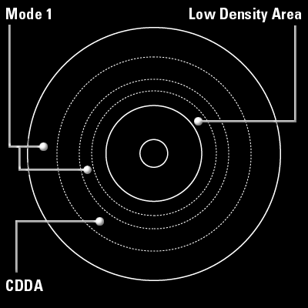
GD Layout

Slide 18
Codescape
Running a program
Dubbing the program
Profiling
Scripting

Slide 19
Running a Program
File/Load Program File…
  Unlock Program File checkbox copies the file, which makes rebuilding the target possible while debugging it
  Run to main()

Slide 20
Running a program
Program control
  Run (F9)
  Restart (Ctrl-Shift-R)
Resetting a lost target
  Soft: resync communication only
  Hard: reset Set5 but not the debug adapter

Slide 21
Debugging
Regions
Breakpoints
Sessions
Configuring the debug adapter

Slide 22
Regions
Strongly-typed views into the memory and processor in the development system
You create a blank region (Ctrl-N) , then specify its type

Slide 23
Region types 1
Source
  Can be viewed as source, disassembly, or both simultaneously
  Set cursor to PC (Ctrl-Shift-P)
  Go to a specific source file (Ctrl-Shift-S)

Slide 24
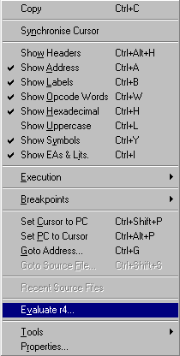
Region types 2
Disassembly
  Headers, Address, Labels,
  Opcode, Symbols...
Field visibility can
be toggled

Slide 25
Region types 3
Memory and registers
  Red highlights changes since last step
  Show floating point registers (Ctrl-L)
  Show banked registers (Ctrl-B)

Slide 26
Region types 4
Local watch
Call stack
Editor

Slide 27
Working with regions
ToolTips
  Hover the cursor over a variable or function for its value or address
Drag and drop
  Example: a variable may be dragged from a source region into a watch region

Slide 28
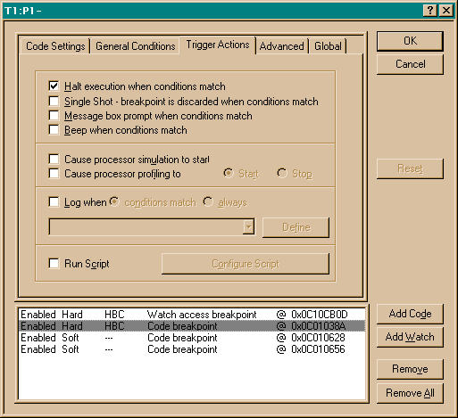
Breakpoints
Toggle
  (F5)
Configure
  (Ctrl-F5)

Slide 29
Configuring breakpoints
General conditions
Trigger actions

Slide 30
General conditions
Breakpoint can be active if
  breakpoint has been passed trigger times
  a boolean expression is true
Useful for finding bugs that only occur after nth iteration

Slide 31
Trigger actions
Tells what to do when breakpoint conditions are met
  Beep, show a dialog box, or halt
  Log a message to the log window

Slide 32
Trigger actions
Logging program execution
  In Advanced tab in Configure breakpoints, set Location Mask Selector to All
  Log expression:
    “Executed 0x%08x -> %i “,pc,pc

Slide 33
Sessions
Contain build options, breakpoints, and region information
  Accessed via the File menu
A loaded session will reset the target back to the previous working state

Slide 34
Configuring the debug adapter
OS Mode
CPU Mode

Slide 35
OS Mode
Runs the boot ROM on startup
Thus the GD-ROM loader program starts in OS Mode
Useful for testing GDs that you burn

Slide 36
CPU Mode
Does not run the boot ROM on startup
Useful for testing your executable (.elf) file

Slide 37
Optimizing your programs
Profiling

Slide 38
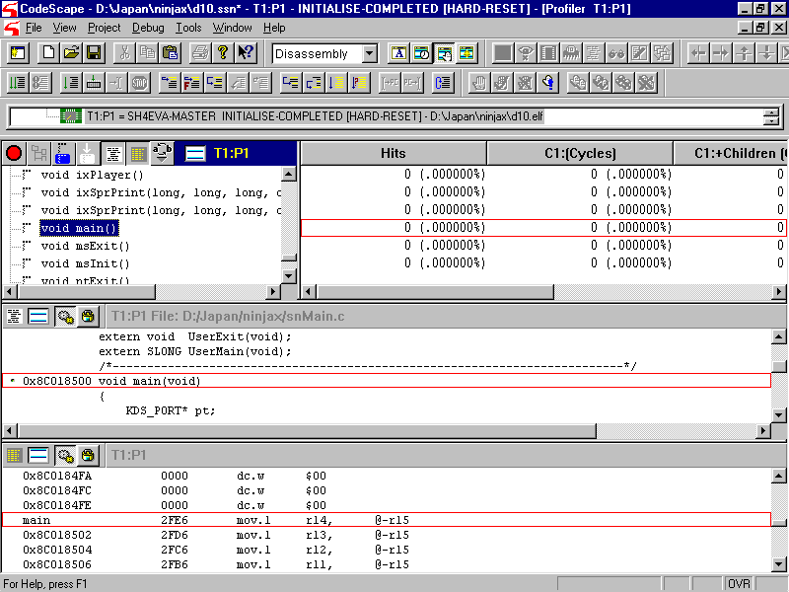
Profiling
Tools/Profiler

Slide 39
Using the profiler
Start your program
Stop your program (at a breakpoint?)
Start the profiler (press the green button)
Stop your program (at a breakpoint?)
Read or export the profile

Slide 40
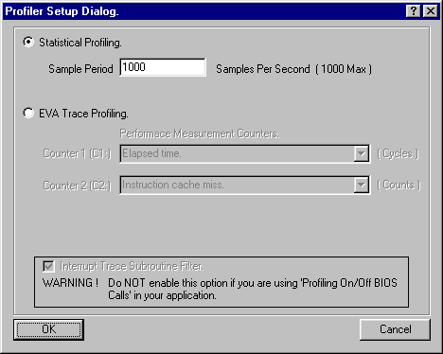
Profiling methods
Statistical profiling
EVA trace

Slide 41
Statistical profiling
Samples the current function at a rate of 1Hz-1kHz
Negligible effect on execution time

Slide 42
EVA trace
Produces accumulative totals and a function call tree
Slows execution time considerably
Depends on two performance counters (C1 and C2)

Slide 43
Exporting a profile
Context menu: File/Save Profile…
Use prfdump to make human readable
  c:\katana\utl\dev\prfdump\prfdump.exe

Slide 44
GD Mastering
An Overview

Slide 45
Bootable Files
All example make files have BIN option
MUST be first (alphabetically) on last Mode1 tack - 1stread.bin

Slide 46
IP.BIN: The First File Loaded
IP.BIN and IP0000.BIN are required for all bootable discs
IP0000.BIN = IP.BIN x 8

Slide 47
Creation of IP Files
IPMaker
  \utl\dev\ipmaker\

Slide 48
Placement of IP Files in the Project
Disc tab in GD Workshop
  System File Area(Single): IP0000.BIN
  System File Area(High): IP.BIN

Slide 49
GD Burning
2 Methods of Burning
  Method 1:
    Good for internal test
    Not acceptable for master submission
  Method 2:
    Acceptable for master submission

Slide 50
Testing the Bootable Project
Close the drawer in GD Workshop
Put dev station in “OS Mode”
  \utl\dev\dacheck
Physically reset the dev station

Slide 51
Burning the Disc: Method 1
This method is NOT valid for master discs
Add the GD Writer
  Configuration\SCSI Bus
  Select GD Writer and “Add as GD Writer”

Slide 52
Burning the Disc: Method 1
Test Burning
  Emulator\Test Write
  Goes through entire process without turning on laser
Burning
  Emulator\Write
  ~1 hour to burn

Slide 53
Burning the Disc: Method 2
Exporting the CRI Script
  GD Workshop
    File\Save As CRI Script

Slide 54
Burning the Disc: Method 2
Converting the script to an image
  Must be done on a machine that has the dev station with the project being emulated
  Utl\dev\cdcraft

Slide 55
Burning the Disc: Method 2
Crfgdc –bld=‘scrfile’ -benv=imf1
  Where scrfile is the exported script file
  Imf1 is used to build a full disc image
  Image file can now be moved to any other PC

Slide 56
Burning the Disc: Method 2
Hardware
  Up to 4 GD Writers can connect directly to a PC
  2 GD Writers per SCSI card
    Adaptec 2940

Slide 57
Burning the Disc: Method 2
GD Writers must be flashed
  \dev\utl\dbflash\gdrflash
  Dld_dos scsicom.bin 5 0 11000
    5 would be the SCSI ID for the burner
    0 would be the ASPI ID for the SCSI card

Slide 58
Burning the Disc: Method 2
Burning with CDCraft
  Crfgdc –wm=imgfile
Other Options:
  -wenv=mltw
  -tck=myimagefile
  -wenv=test

